Slide 1

7th Grade Math
Unit 4, Lesson 6 Finding Circumference Volume 1, pg. 152

Slide 2


Benchmark
MA.7.GR.1.3
Explore the proportional relationship between circumferences and diameters of circles. Apply a formula for the circumference of a circle to solve mathematical and real-world problems.
volume 1, pg. 152

Slide 3
Integrated Mathematical Thinking and Reasoning Standards
MA.K12.MTR.1.1 Actively participate in effortful learning both individually and collectively.
MA.K12.MTR.2.1 Demonstrate understanding by representing problems in multiple ways.
MA.K12.MTR.4.1 Engage in discussions that reflect on the mathematical thinking of self and others.
MA.K12.MTR.5.1 Use patterns and structure to help understand and connect mathematical concepts.
volume 1, pg. 152

Slide 4

Learning Target
I can find the circumference of a circle.
volume 1, pg. 152

Slide 5

Warm-Up
volume 1, pg. 153

Slide 6
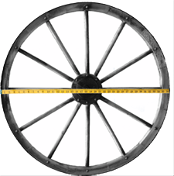
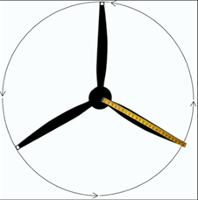
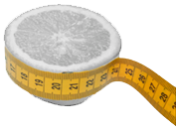
4.6.1 Warm-Up: Circular Objects
Three pictures of circular objects, with measurement tools, are shown. The measurement tool on each picture reads as follows:
Wagon wheel: 3 feet (ft)
Plane propeller: 24 inches (in)
Sliced Orange: 20 centimeters (cm)
Wagon Wheel | Plane Propeller | Sliced Orange
volume 1, pg. 153
Notes:
Video Link: https://algebranation.wistia.com/medias/fi4fidi5y8

Slide 7
For each object, what does the measurement represent?
Choose one of the objects and explain why you think it would be helpful to know the measurement given.
Wagon Wheel | Plane Propeller | Sliced Orange
radius diameter circumference | radius diameter circumference | radius diameter circumference
volume 1, pg. 153
Notes:
Video Link: https://algebranation.wistia.com/medias/fi4fidi5y8

Slide 8

Guided Instruction
volume 1, pg. 153

Slide 9

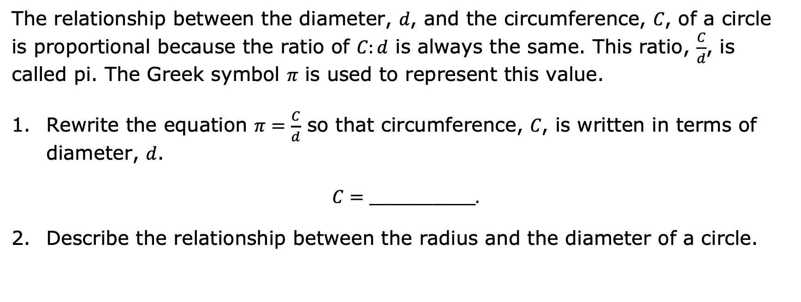
4.6.2 Guided Instruction: Circumference
The relationship between the diameter, 𝑑, and the circumference, 𝐶, of a circle is proportional because the ratio of $C:d$ is always the same. This ratio, $\frac{C}{d}$, is called pi. The Greek symbol 𝜋 is used to represent this value.
Rewrite the equation $π=\frac{C}{d}$ so that circumference, 𝐶, is written in terms of diameter, 𝑑.
$C=_______________.$
Describe the relationship between the radius and the diameter of a circle.
volume 1, pg. 153

Slide 10

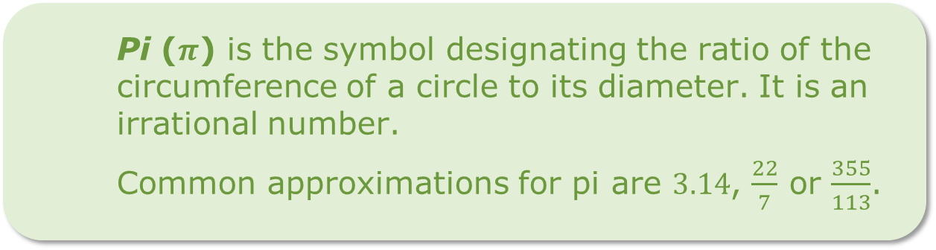
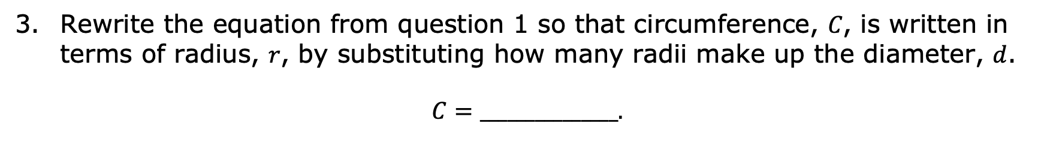
Rewrite the equation from question 1 so that circumference, 𝐶, is written in terms of radius, 𝑟, by substituting how many radii make up the diameter, 𝑑.
$C=_______________.$
Pi ($π$) is the symbol designating the ratio of the circumference of a circle to its diameter. It is an irrational number.
Common approximations for pi are $3.14$, $\frac{22}{7}$ or $\frac{355}{113}$.
volume 1, pg. 153

Slide 11
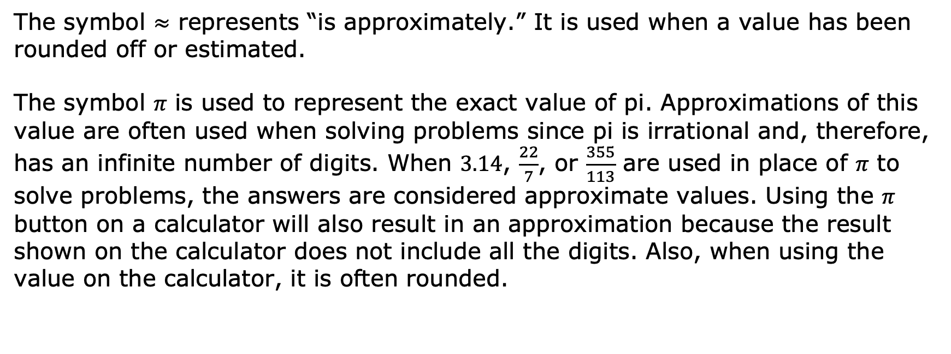
The symbol $≈$ represents “is approximately.” It is used when a value has been rounded off or estimated.
The symbol 𝜋 is used to represent the exact value of pi. Approximations of this value are often used when solving problems since pi is irrational and, therefore, has an infinite number of digits. When $3.14$, $\frac{22}{7}$, or $\frac{355}{113}$ are used in place of 𝜋 to solve problems, the answers are considered approximate values. Using the 𝜋 button on a calculator will also result in an approximation because the result shown on the calculator does not include all the digits. Also, when using the value on the calculator, it is often rounded.
volume 1, pg. 154

Slide 12
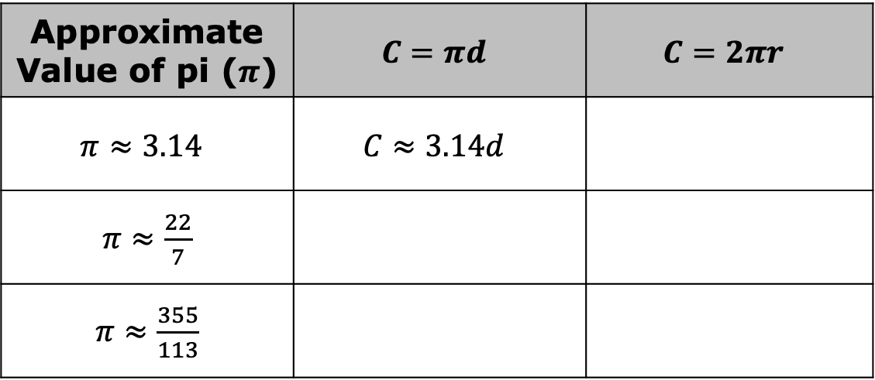
Complete the table to rewrite the circumference formulas using the common approximations for 𝜋.
Approximate Value of pi ($π$) | $$C=πd$$ | $$C=2πr$$
$$π≈3.14$$ | $$C≈3.14d$$
$π≈\frac{22}{7}$
$π≈\frac{355}{113}$
volume 1, pg. 154

Slide 13
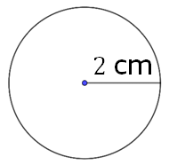
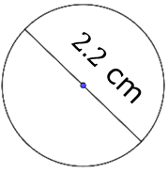
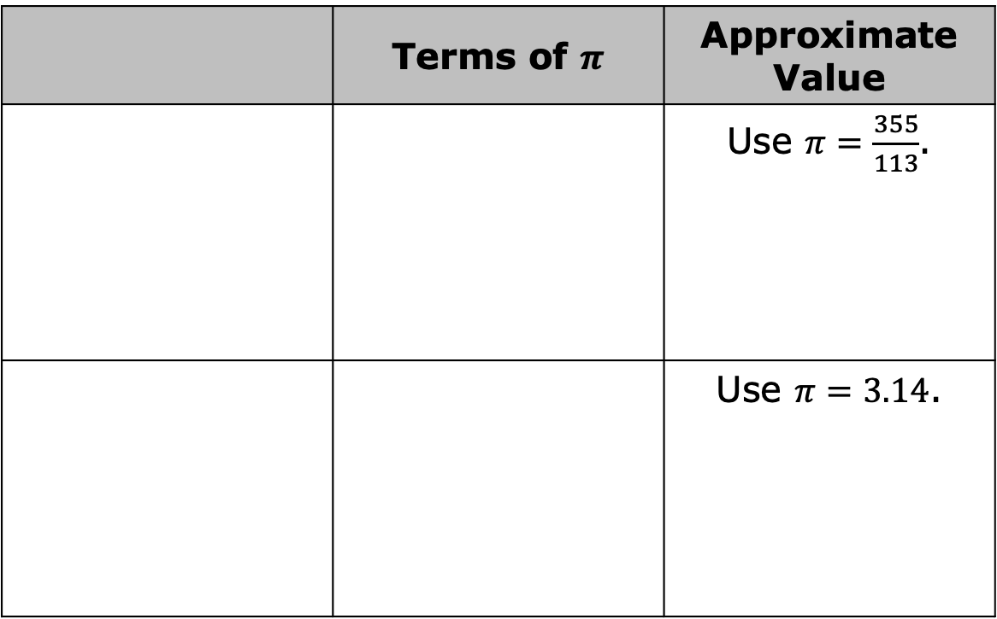
Determine the circumference of each circle, both in terms of 𝜋 and the approximation. For approximate values, use the approximation listed. Lengths are given in centimeters (cm). The circles are not drawn to scale.
 | Terms of $π$ | Approximate Value
 |  | Use $π=\frac{355}{113}$.
 |  | Use $π=3.14$.
volume 1, pg. 154

Slide 14
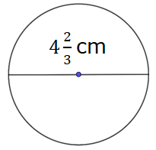
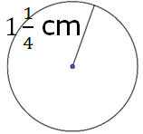
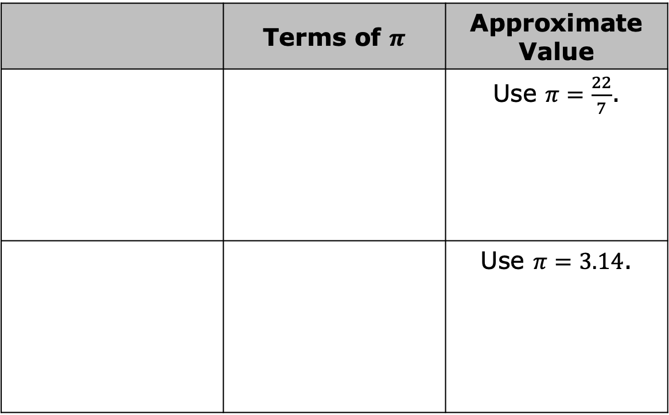
 | Terms of $π$ | Approximate Value
 |  | Use $π=\frac{22}{7}$.
 |  | Use $π=3.14$.
volume 1, pg. 154

Slide 15

Guided Practice
volume 1, pg. 155

Slide 16

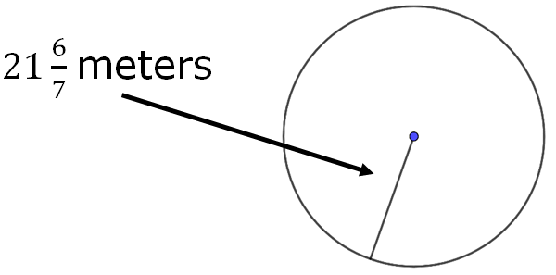
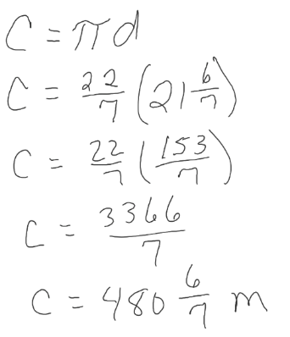

4.6.3 Guided Practice: Error Analysis
Delanie used $π=\frac{22}{7}$ to find the circumference of the circle shown.
Delanie’s work is shown.
Delanie’s Work
volume 1, pg. 155

Slide 17
Examine Delanie’s work and write an explanation to her of any errors.
What is the circumference of the circle?
volume 1, pg. 155

Slide 18

Your Turn
volume 1, pg. 155

Slide 19
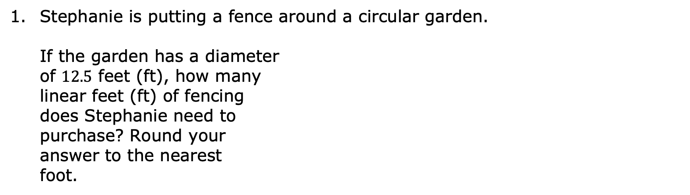
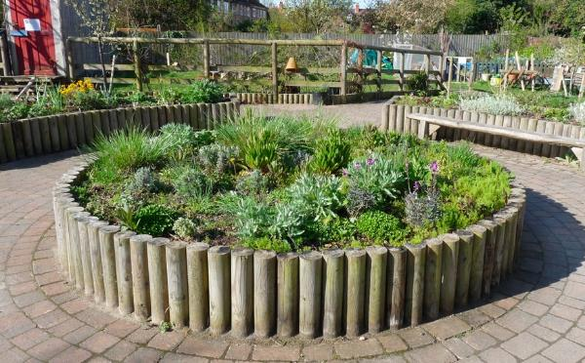
4.6.4 Your Turn!
Stephanie is putting a fence around a circular garden. If the garden has a diameter of $12.5$ feet (ft), how many linear feet (ft) of fencing does Stephanie need to purchase? Round your answer to the nearest foot.
volume 1, pg. 155

Slide 20

Rachel needs a new tube for her bicycle tire. The tire has a radius of $13$ inches (in.). What is the circumference of the tire tube that Rachel should buy?
volume 1, pg. 156

Slide 21
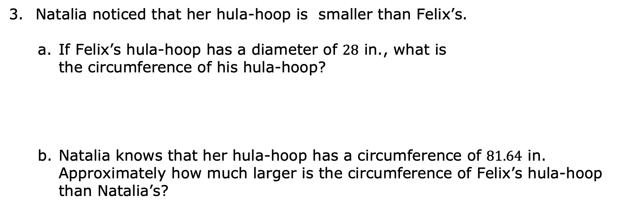
Natalia noticed that her hula-hoop is smaller than Felix’s.
If Felix’s hula-hoop has a diameter of $28$ in., what is the circumference of his hula-hoop?
Natalia knows that her hula-hoop has a circumference of $81.64$ in. Approximately how much larger is the circumference of Felix’s hula-hoop than Natalia’s?
volume 1, pg. 156

Slide 22

Wrap-Up
volume 1, pg. 156

Slide 23
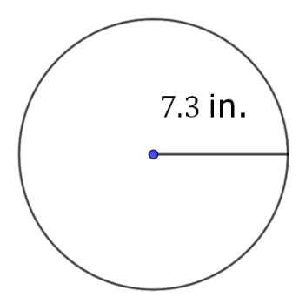
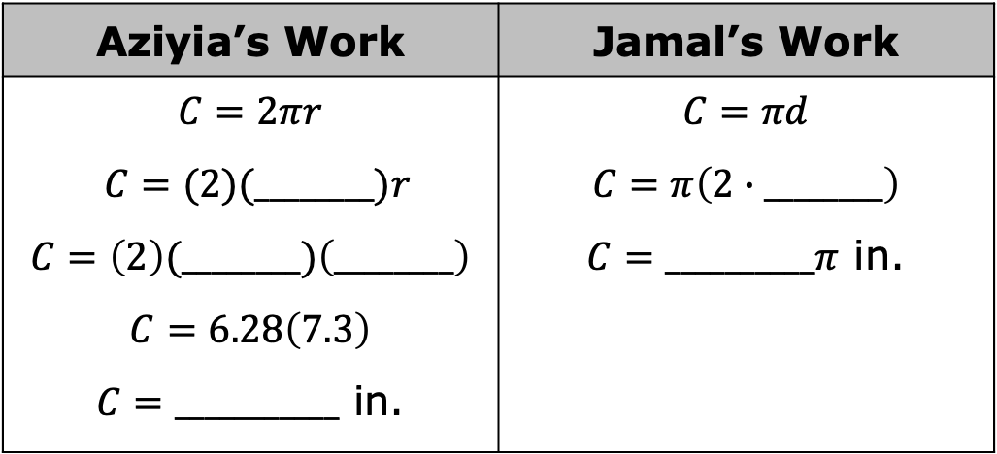
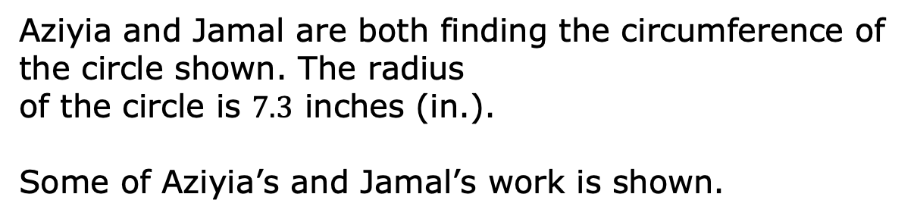
4.6.5 Wrap-Up: Ticket Out the Door
Aziyia and Jamal are both finding the circumference of the circle shown. The radius of the circle is $7.3$ inches (in.).
Some of Aziyia’s and Jamal’s work is shown.
Aziyia’s Work | Jamal’s Work
$$C=2πr$$ $C=(2)(________)r$ $$C=\left(2\right)(________)\left(________\right)$$ $$C=6.28\left(7.3\right)$$ $C=___________$ in. | $$C=πd$$ $$C=π\left(2∙________\right)$$ $C=__________π$ in.
volume 1, pg. 156

Slide 24
Complete each person’s work.
Explain which answer is more accurate.
volume 1, pg. 156

